Slide 1
Deep learning

Slide 2
Agenda
Deep learning introduction
Neural network architecture
Perceptron model
Multi layer perceptron model
Optimization – gradient descent
Back propagation
Deep neural networks

Slide 3
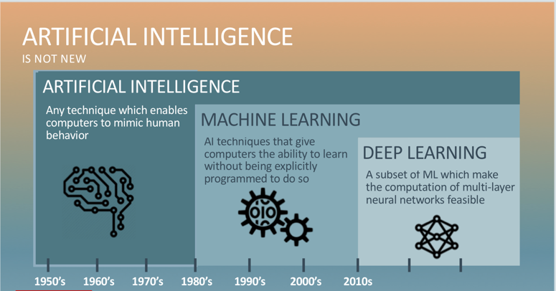
History

Slide 4
Why deep learning - Performance vs Sample Size
Deep Learning algorithms
Performance
Traditional ML algorithms
Size of Data

Slide 5
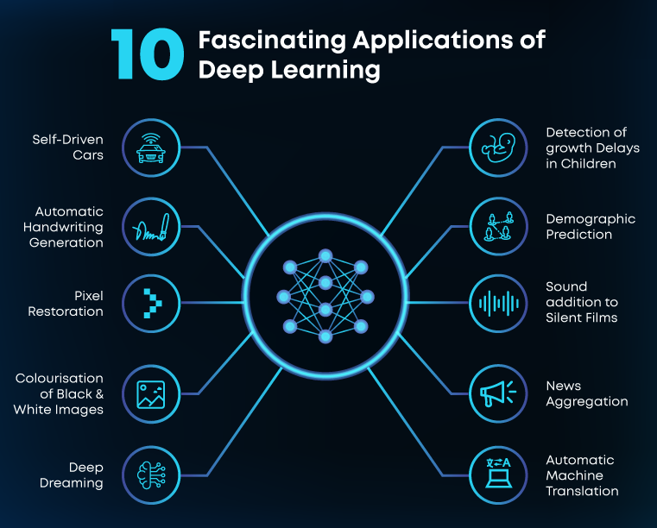
Applications of deep learning

Slide 6
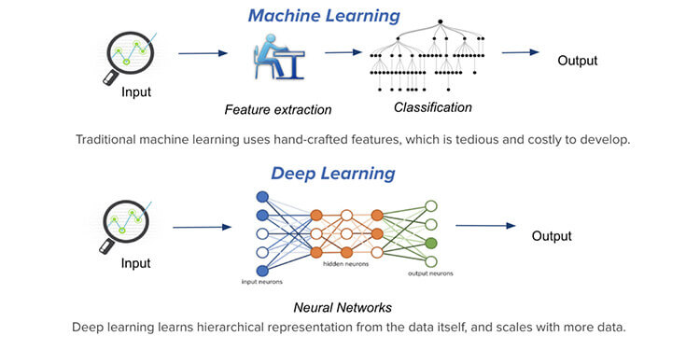
ML vs DL

Slide 7
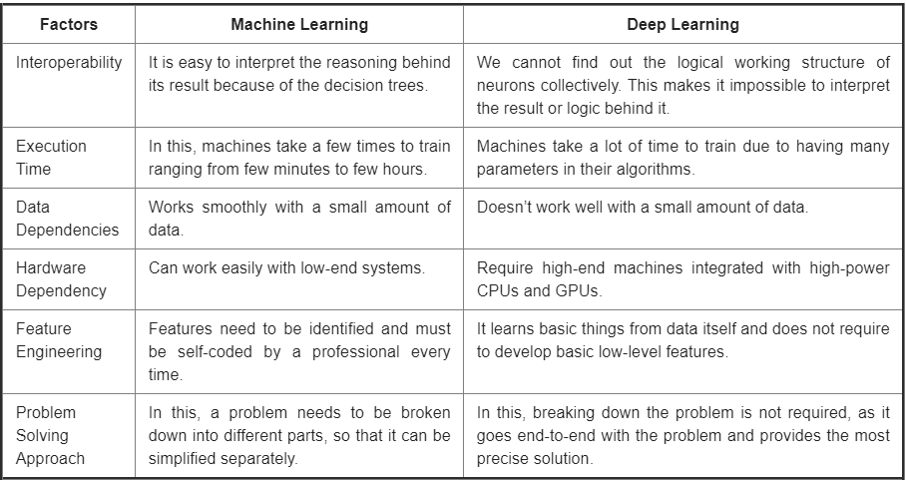
ML vs DL
Data Dependencies
Hardware Dependencies
Execution time
Feature engineering
Problem Solving approach
Interpretability

Slide 8
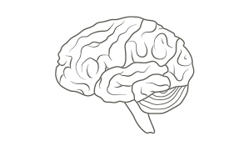
The Human Brain
Basic unit of information processing – “Neuron”
Number of neurons – 1011
Average number of connections per neuron – 103 or 104
The communication speed is much slower – order of a few milliseconds
Complex perceptual decisions take just a few 100 millisecs
100 step rule
Any perceptual task may not be passing through more than 100 neurons

Slide 9
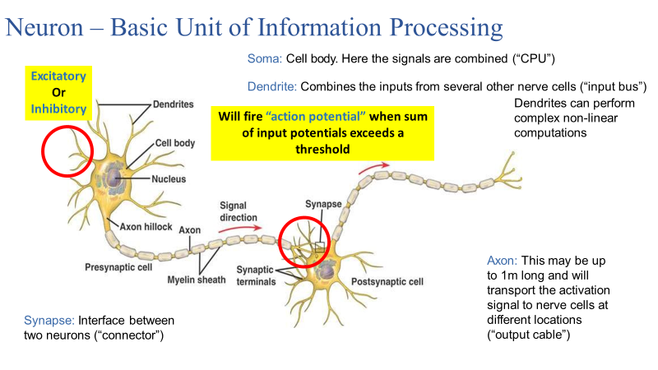

Slide 10
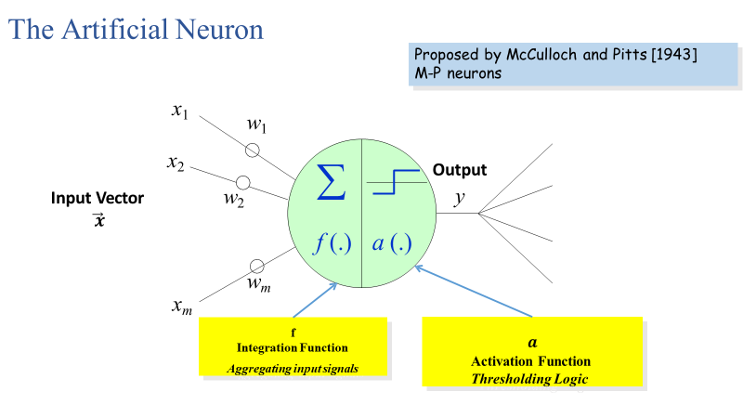
Artificial Neural network architecture – Neuron

Slide 11
Neuron computation

Slide 12
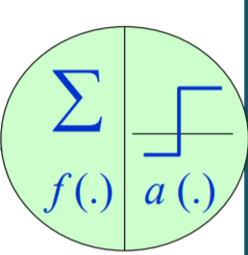
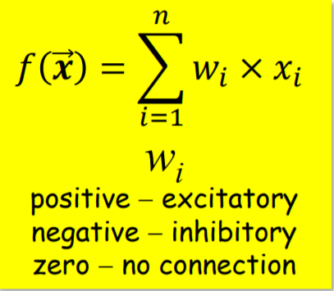
NN architecture – Integration function ∑
Responsible for aggregating input signals from other neurons
Controls boosting, inhibiting or completely suppressing the given input
Most common integration function

Slide 13


∑
NN architecture – Activation functions a (.)
f (.) a (.)
1
_{1+ e}−λf
f > 1
a( f ) = ⎪ f 0 ≤ f ≤ 1
f < 0
⎧1
⎧1 f ≥ 0
⎩0 otherwise
⎨
a( f ) =
a( f ) = ⎨
⎪₀
⎩
a
1.5
a
1
1
1
0.5
1
f
0
0
f
-4
-3
-2
-1
1
2
3
4
Step function
Ramp function
Sigmoid function

Slide 14
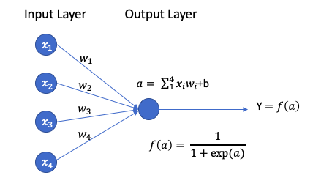
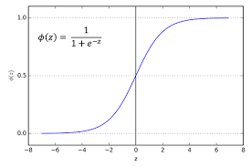
Neuron nothing but a logistic regression
Sigmoid function

Slide 15
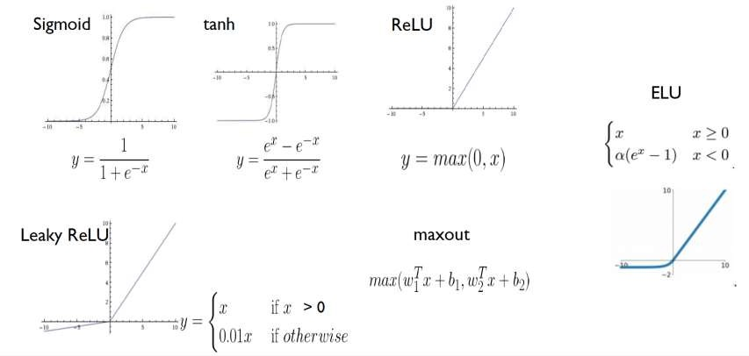
Activation Functions
Activation Function | Pros | Cons
Sigmoid | Used in the output layer for binary classification | Output ranges from 0 to 1
tanh | Better than sigmoid | Updates parameters slowly when points are at extreme ends
ReLU | Updates parameters faster as slope is 1 when x>0 | Zero slope when x<0

Slide 16
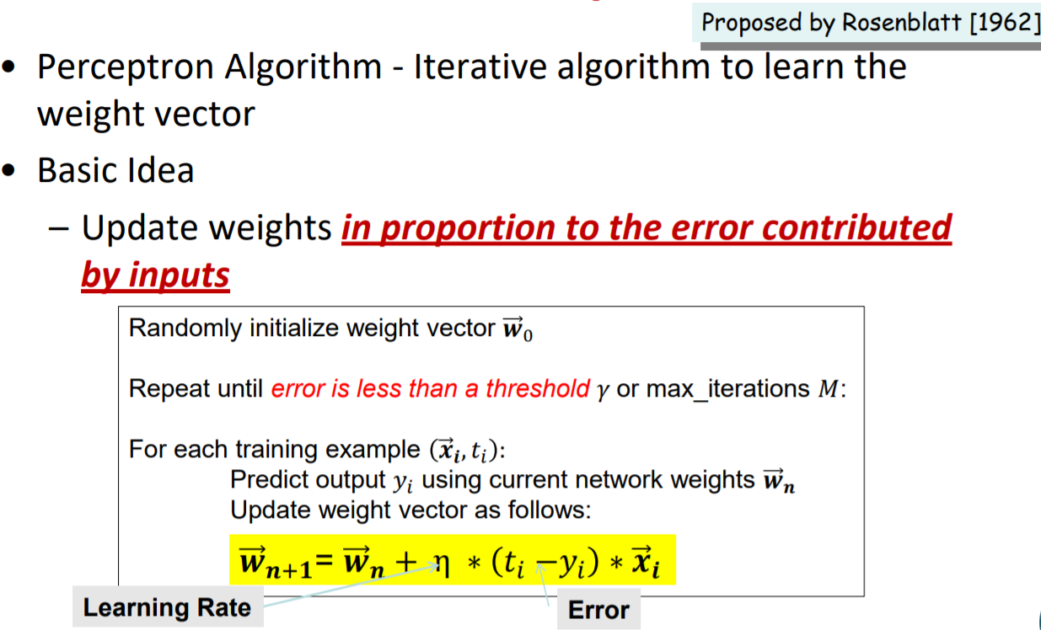
How to train a Perceptron?
The perceptron is a mathematical model of a biological neuron

Slide 17
Perceptron – Toy Example
2
1.5
4 points are linearly separable
(1/2, 1)
1
(-1,1/2)
0.5
(1,1/2)
0
Z = 1
Z = 0
-0.5
(-1,1)
-1
-1.5
-2
-2
-1.5
-1
-0.5
0
0.5
1
1.5
2

Slide 18
Perceptron – Toy Example (Contd..)
initial weights
2
1.5
1
W(0) = (0,1)
0.5
η = 1/3 , W(0) = (0,1)
𝑤_{𝑛+1} = 𝑤_{𝑛} + η ∗ 𝑡_{𝑖} − 𝑦_{𝑖} ∗ 𝑥
W(1)_x = 0 + 1/3 *(-1) * (-1) = 1/3
W(1)_y = 1 + 1/3 * (-1) * (1/2) = 5/6
W(1) = (1/3,5/6)
Z = 1
0
Z = 0
-0.5
-1
-1.5
-2
-2
-1.5
-1
-0.5
0
0.5
1
1.5
2

Slide 19
Perceptron – Toy Example (Contd..)
first correction
2
1.5
W(1) = (1/3,5/6)
1
η = 1/3 , W(1) = (1/3,5/6)
𝑤_{𝑛+1} = 𝑤_{𝑛} + η ∗ 𝑡_{𝑖} − 𝑦_{𝑖} ∗ 𝑥
W(2)_x = 1/3 + 1/3 *(-1) * (-1) = 2/3
W(2)_y = 5/6 + 1/3 * (-1) * (1/2) = 4/6
= 2/3
W(2) = (2/3,2/3)
0.5
0
-0.5
-1
-1.5
-2
-2
-1.5
-1
-0.5
0
0.5
1
1.5
2

Slide 20
Perceptron – Toy Example (Contd..)
second correction
2
1.5
1
0.5
0
-0.5
-1
-1.5
-2
 |  |  |  |  | W | (2) = (2 | /3,2/3)
-2
-1.5
-1
-0.5
0
0.5
1
1.5
2
Correction of weights turned out to be a
rotation of the separating hyper plane

Slide 21
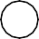

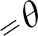

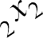
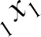

What can be achieved by single Perceptron?
Minsky et. al. proved single M-P neuron no
better than a linear classifier [1969]
x₁
w
1
x₂
∑
f (.) a (.)
y
w₂
0
x
2
w_{m}
θ
x
m
1
1
x₁
Bias Term

Slide 22
Learning Non-Linear Patterns
Non-Linear Patterns
Change Integration Function
Multi-Layered Perceptrons

Slide 23


Changing Integration Functions
Very similar to the Kernel Trick in SVMs!
∑
f (.) a (.)
Quadratic Function
Spherical Function
m
f = ∑ w x² −θ
What integration functions can we have?
j j
j =1
m
f = ∑(x − w )² −θ
j j
j =1

Slide 24
Feed forward neural network
It is feed forward
Connections from inputs towards outputs
No connection backwards
It consists of layers
Current layer’s input is previous layer’s output
No lateral connections (intra layer)

Slide 25
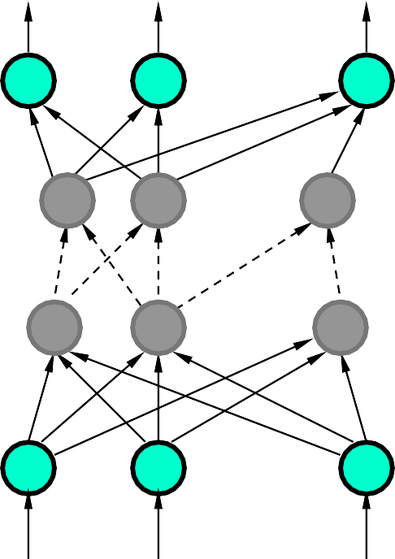
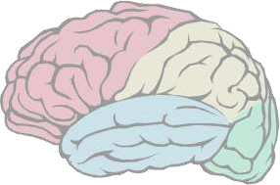
Multi-Layered Perceptrons (MLPs)
y₁ y₂
y_{n}
Output Layer
. . .
. . .
Hidden Layer
. . .
. . .
Input Layer
x₁ x₂
x_{m}

Slide 26
What kind of Decision Boundaries do MLPs learn?
y
L₁
x−1=0
L₃
−x−y+4=0
θ₁=1
θ₂=1
θ₃= −4
L₁
L₂
L₃
L₂
y−1=0
x
0
−1
1
1
−1
0
x
y

Slide 27
Layer-wise Activation Regions
010
y
L₁
Region Code
L₃
011
110
L₁
L₂
L₃
111
L₂
001
101
100 x
x
y

Slide 28
Capturing Non-Linearity through Layer Addition
y
z
L₁
z=0
θ₄=2.5
L₄
L₃
1
1
1
L₁
L₂ L₃
z=1
L
2
x
x
y

Slide 29


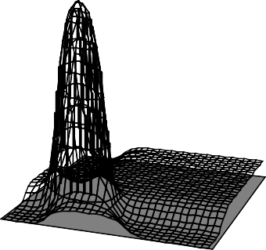
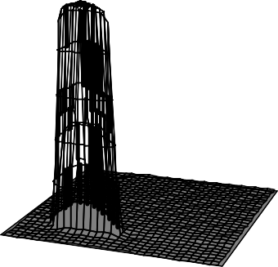
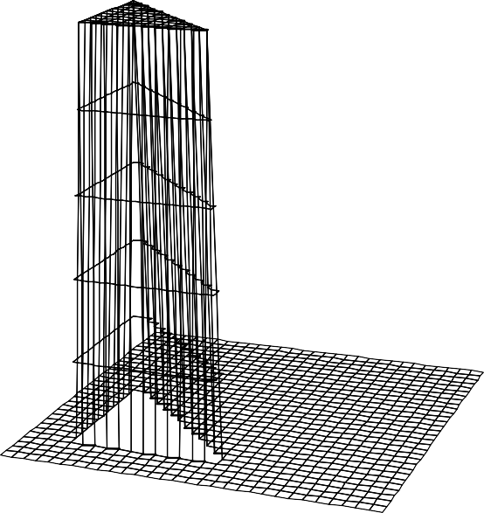
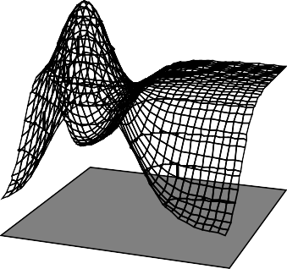
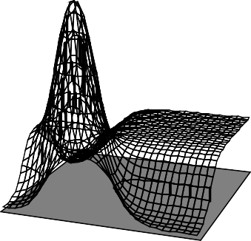
Effect of Changing Activation Functions
z
L₄
1
_{1+ e}−λf
Step function
Sigmoid function
a( f ) =
L₁
L₂ L₃
f ≥ 0
⎩0 otherwise
a( f ) = ^{⎧1}
⎨
λ=5
x
y
λ=10
λ=2
λ=3

Slide 30
Optimization

Slide 31
Optimization algorithm - Gradient descent
1. Gradient descent is an optimization algorithm used to find the values of parameters (coefficients) of a function (f) that minimizes a cost function (cost).
2. Gradient descent is an optimization algorithm used to minimize some function(loss/cost) by iteratively moving in the direction of steepest descent as defined by the negative of the gradient.
3. In machine learning, we use gradient descent to update the parameters of our model. Parameters refer to coefficients in Linear Regression and weights in neural networks.

Slide 32
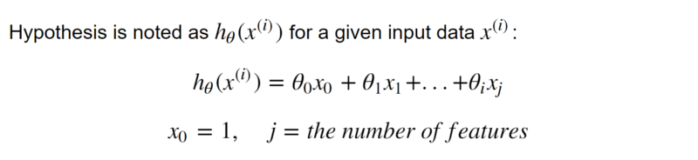
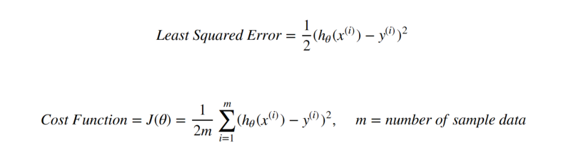
Loss/Error Function – MSE (regression)
Goal is to reduce the error/loss
Find right set of weights for minimal loss

Slide 33
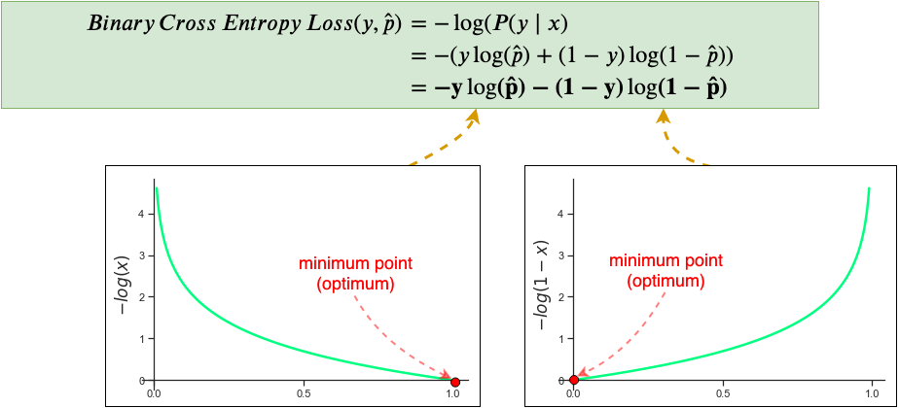
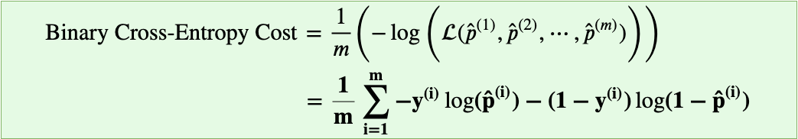
Loss/Error Function – Cross entropy (classification)
Goal is to reduce the error/loss
Find right set of weights for minimal loss
CE loss also called log loss quantifies the deviation between predicted output and ground truth
Ideally prediction would have zero loss
With Gradient Descent , we will try to reduce the error

Slide 34
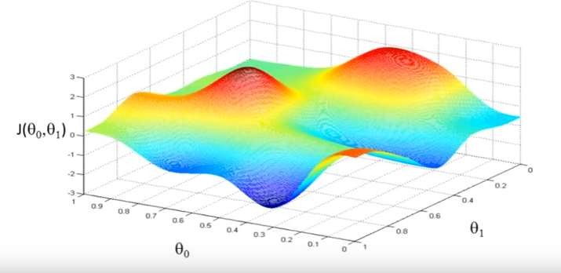
Error surface
Cost as a function of weights
J(𝜃₀, 𝜃₁)

Slide 35
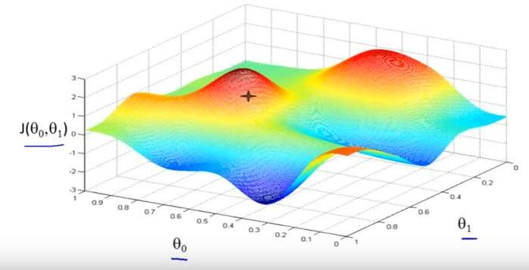
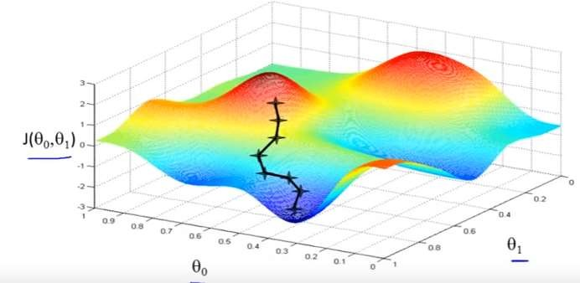
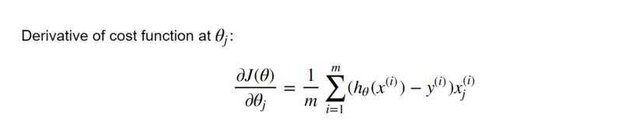
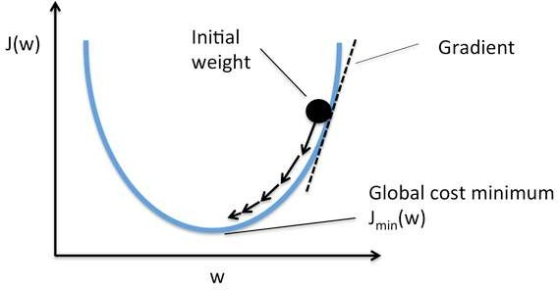
Moving down the hill

Slide 36
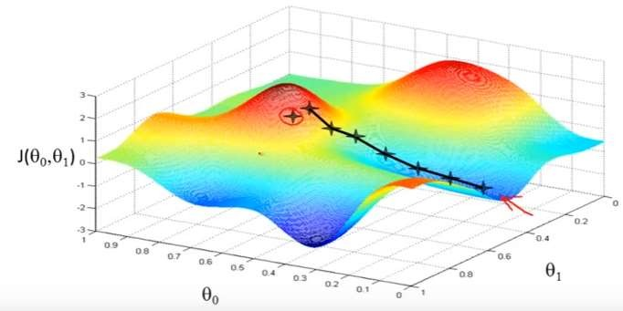
Local minima issues in gradient descent learning

Slide 37
Parameters vs Hyperparameters
The major difference between parameters and hyperparameters is that parameters are learned by the model during the training time, while hyperparameters can be changed before training the model.
Parameters of a deep neural network are W and b, which the model updates during the backpropagation step
There are a lot of hyperparameters for a deep NN, including:
Learning rate – ⍺
Number of iterations
Number of hidden layers
Units in each hidden layer
Choice of activation function

Slide 38
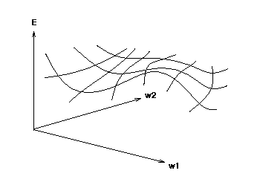
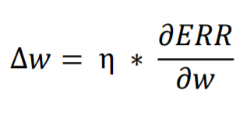
How to find derivatives – Back propagation
Back Propagation Algorithm is used while training feed forward NN
It helps in efficiently calculating the gradient of the loss function with respect to weights
Update each weight in the direction where overall error function decreases
Performs gradient descent on error surface
It helps in minimizing loss by updating weights
Error as a function of weights

Slide 39
Backpropagation steps
Initialize network/Model
Fully connected layer – forward propagation
Fully connected layer – backward propagation
Transfer derivative
Error Back propagation
Update weights

Slide 40
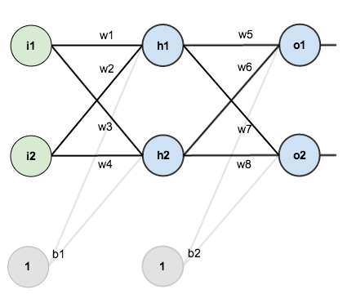
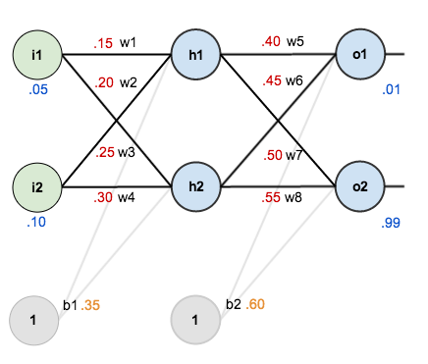
Back propagation example
Step1 : Initialize network/Model

Slide 41
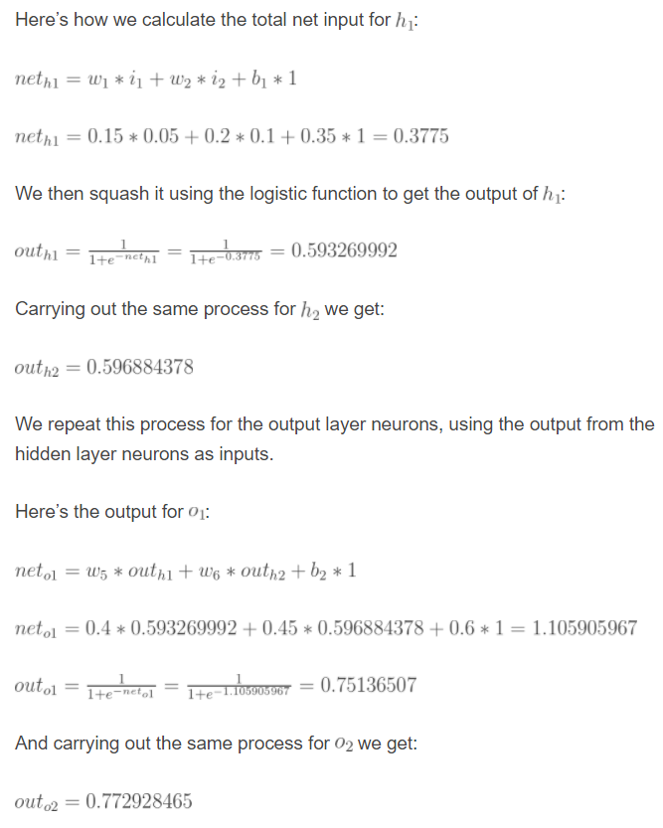
Back propagation example –contd..
Step 2: Forward Propagate

Slide 42
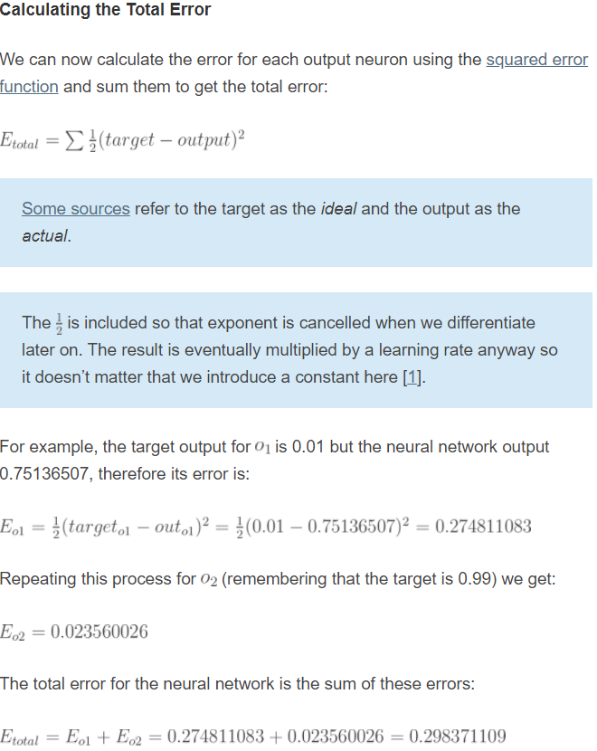
Back propagation example –contd..
Step 2: Forward Propagate

Slide 43
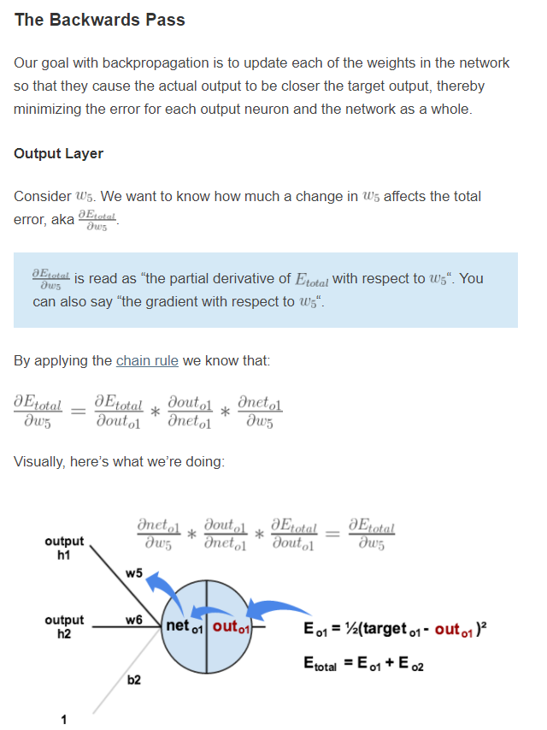
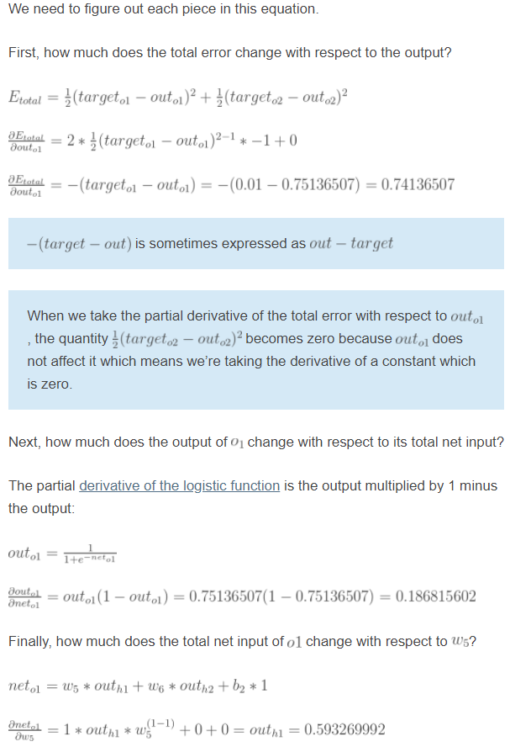
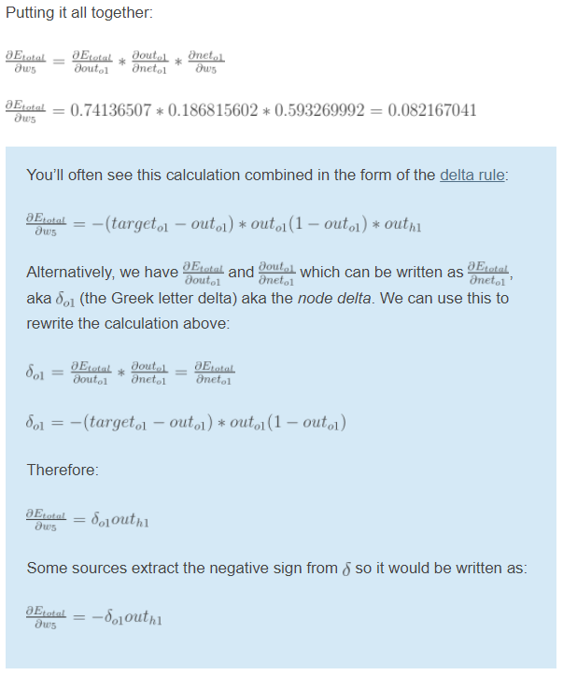
Step3: Backward propagation – Transfer derivatives

Slide 44
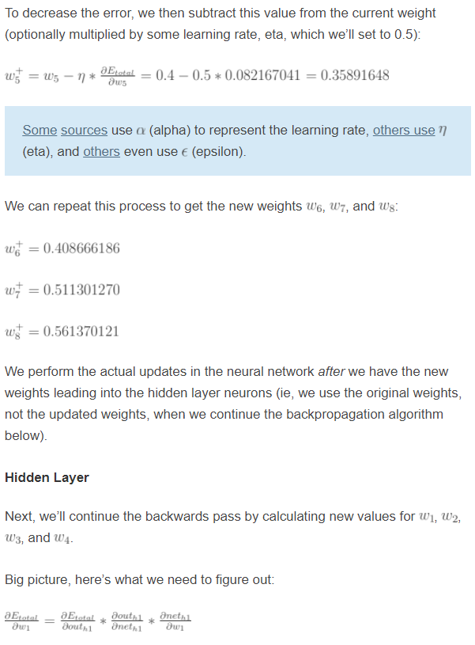
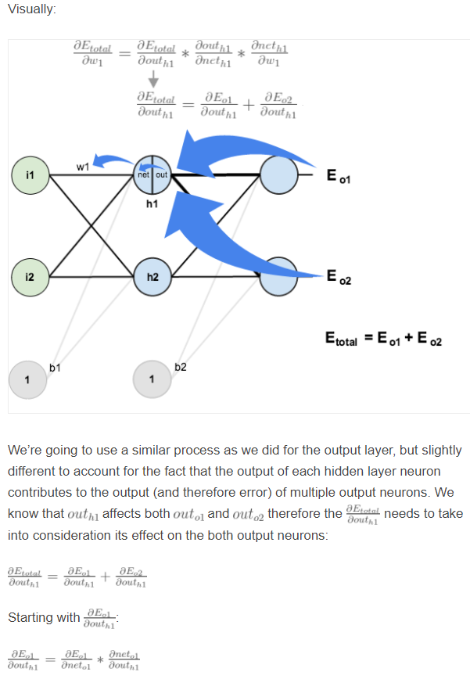
Step3: Backward propagation – Error back propagation and update weights

Slide 45
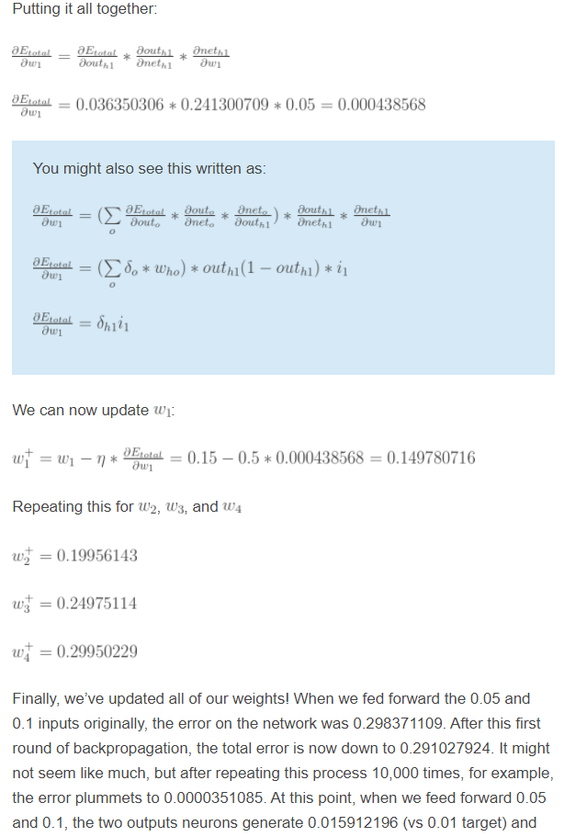
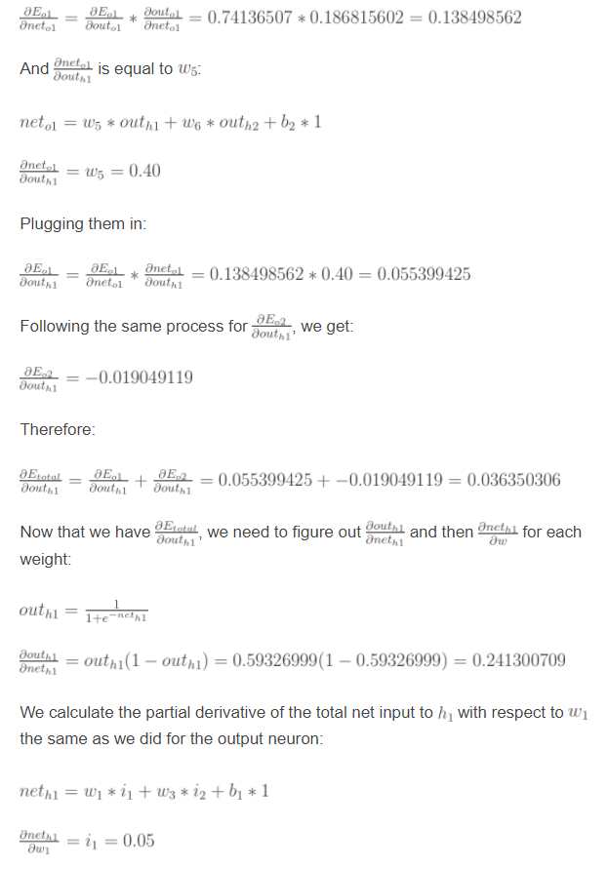
Step3: Backward propagation – Error back propagation and Updating weights

Slide 46
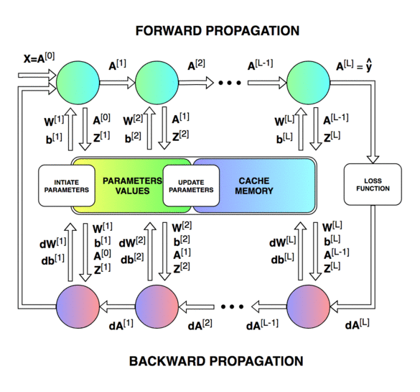
Visualizing back propagation

Slide 47
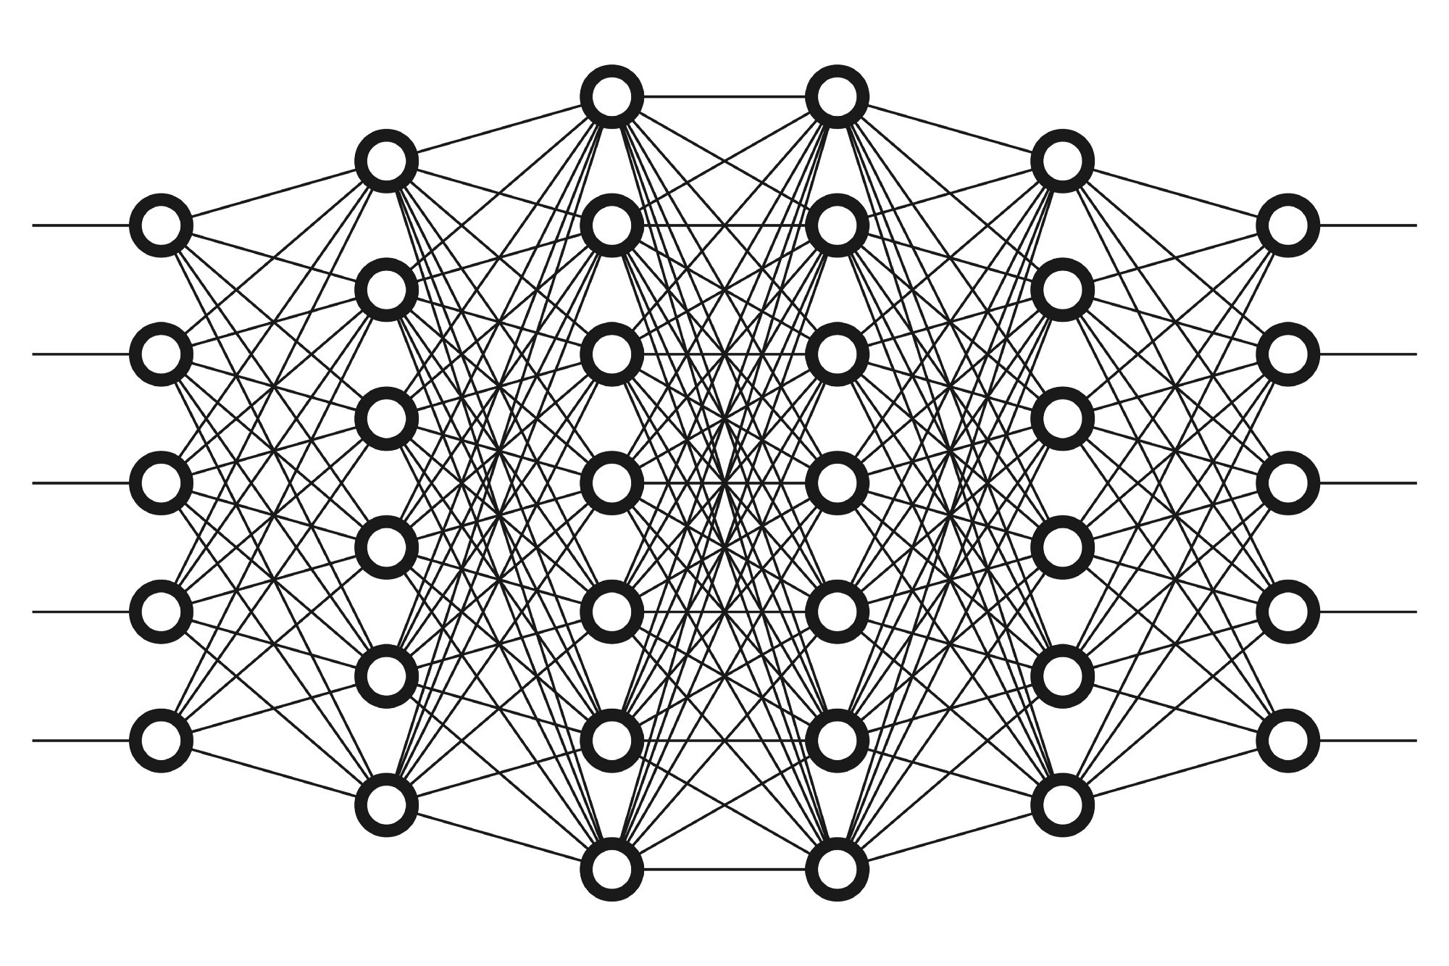
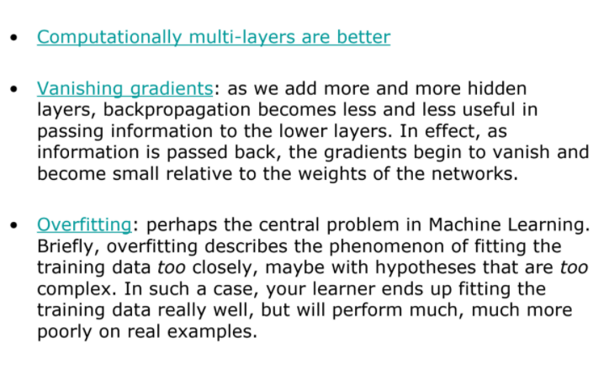
Deep Neural network – Many layers

Slide 48
Deep learning concepts
Gradient descent variations
Different optimizers
Softmax
Vanishing and Exploding gradient problem
Overfitting problem
Simplifying The Model
Early Stopping
Use Data Augmentation
Regularization techniques
Dropout

Slide 49







Gradient descent variations
Batch Gradient descent
Stochastic gradient descent
Mini-batch gradient descent

Slide 50


Different optimizers – Hyper parameter

Slide 51



Softmax
Softmax is multinomial logistic classifier , it can handle multiple classes
Softmax is typically the last layer of NN
Softmax itself is an activation function , hence it need not be combined with any activation function

Slide 52
Exploding and Vanishing gradients
When training a deep neural network with gradient based learning and backpropagation, we find the partial derivatives by traversing the network from the final layer (y̑) to the initial layer. Using the chain rule, layers that are deeper into the network go through continuous matrix multiplications in order to compute their derivatives.
In a network of n hidden layers, n derivatives will be multiplied together. If the derivatives are large then the gradient will increase exponentially as we propagate down the model until they eventually explode, and this is what we call the problem of exploding gradient. Alternatively, if the derivatives are small then the gradient will decrease exponentially as we propagate through the model until it eventually vanishes, and this is the vanishing gradient problem.

Slide 53

Exploding gradient
How to identify
The model is not learning much on the training data therefore resulting in a poor loss.
The model will have large changes in loss on each update due to the models instability.
The models loss will be NaN during training.
Model weights grow exponentially and become very large when training the model.
The model weights become NaN in the training phase.
The derivatives are consistently above 1
Solutions
Re-Design the Network Model
Use Long Short-Term Memory Networks
Use Weight Regularization
Use Gradient Clipping

Slide 54
Vanishing gradient
How to identify
The model will improve very slowly during the training phase and it is also possible that training stops very early, meaning that any further training does not improve the model.
The weights closer to the output layer of the model would witness more of a change whereas the layers that occur closer to the input layer would not change much (if at all).
Model weights shrink exponentially and become very small when training the model.
The model weights become 0 in the training phase.
Solutions
Re-Design the Network Model
Use Long Short-Term Memory Networks
3. Use Weight Regularization

Slide 55



Overfitting – High variance problem

Slide 56
Overfitting – Simplifying the model
The first step when dealing with overfitting is to decrease the complexity of the model.
To decrease the complexity, we can simply remove layers or reduce the number of neurons to make the network smaller. While doing this, it is important to calculate the input and output dimensions of the various layers involved in the neural network. There is no general rule on how much to remove or how large your network should be. But, if your neural network is overfitting, try making it smaller.

Slide 57

Overfitting - Early stopping
Early stopping is a form of regularization while training a model with an iterative method, such as gradient descent.
Since all the neural networks learn exclusively by using gradient descent, early stopping is a technique applicable to all the problems. This method update the model so as to make it better fit the training data with each iteration. Up to a point, this improves the model’s performance on data on the test set. Past that point however, improving the model’s fit to the training data leads to increased generalization error.
Early stopping rules provide guidance as to how many iterations can be run before the model begins to overfit.
After some iterations, test error has started to increase while the training error is still decreasing. Hence the model is overfitting. So to combat this, we stop the model at the point when this starts to happen.

Slide 58

Overfitting - Data Augmentation
Data augmentation simply means increasing size of the data that is increasing the number of images present in the dataset.
Some of the popular image augmentation techniques are flipping, translation, rotation, scaling, changing brightness, adding noise etc.
As we can see, using data augmentation a lot of similar images can be generated. This helps in increasing the dataset size and thus reduce overfitting.
The reason is that, as we add more data, the model is unable to overfit all the samples, and is forced to generalize.

Slide 59



Overfitting - Regularization
Regularization is a technique to reduce the complexity of the model. It does so by adding a penalty term to the loss function. The most common techniques are known as L1 and L2 regularization.
The L1(Lasso) penalty aims to minimize the absolute value of the weights.
The L2 (Ridge)penalty aims to minimize the squared magnitude of the weights.
So which technique is better at avoiding overfitting? The answer is — it depends.
If the data is too complex to be modelled accurately then L2 is a better choice as it is able to learn inherent patterns present in the data.
While L1 is better if the data is simple enough to be modelled accurately. L1 has an added advantage of being robust to outliers.

Slide 60

Overfitting - Dropout
Dropout is a regularization technique that prevents neural networks from overfitting.
Regularization methods like L1 and L2 reduce overfitting by modifying the cost function. Dropout on the other hand, modify the network itself.
It randomly drops neurons from the neural network during training in each iteration.
When we drop different sets of neurons, it’s equivalent to training different neural networks.
The different networks will overfit in different ways, so the net effect of dropout will be to reduce overfitting.

Slide 61

Overfitting - Dropout
The term “dropout” refers to dropping out units (hidden and visible) in a neural network.
By dropping a unit out, we mean temporarily removing it from the network, along with all its incoming and outgoing connections, as shown in Figure.
The choice of which units to drop is random.
In the simplest case, each unit is retained with a fixed probability p independent of other units, where p can be chosen using a validation set or can simply be set at 0.5, which seems to be close to optimal for a wide range of networks and tasks.
For the input units, however, the optimal probability of retention is usually closer to 1 than to 0.5.

Slide 62


Deep Learning Libraries
 | Caffe | Torch | Theano | Tensorflow
Language | C++ | Lua | Python | Python
Multi-GPU | Yes | Yes | OK | Yes
Readability | Yes | Yes | V. Poor | V. Poor
Complex models | No | Yes | Yes | Yes
Visualization | No | OK | No | Yes
Training | Windows/Linux | Linux only | Windows/Linux | Windows/Linux

Slide 63


Deep Learning Libraries

Slide 64
Set up
Prerequisites: Anaconda
Tensorflow and keras installation : https://towardsdatascience.com/https-medium-com-ekapope-v-install-tensorflow-and-keras-using-anaconda-navigator-without-command-line-b0bc41dbd038
If you have GPU, install tensorflow GPU. Can also handle multiple GPU

Slide 65
Let us look at Tensor Flow & Keras example

